Slide 1
Crime Rate Vs. Income Level in Atlanta
By: The Data Boys (Angel, Nic, Luminda, Aaron, Grant)

Slide 2
Introduction
We wanted to see if there was any correlation between a neighborhood’s median income and it’s level of crime
Our Hypothesis: Neighborhoods with a higher median income would have a lower number of crimes per-capita
Our Null Hypothesis: There is no relationship between income level and crimes per-capita in a given neighborhood
We believe exploring this topic is important because it will tell us if living an expensive neighborhood is more safe than living in a poorer neighborhood

Slide 3
Questions & Data
We used Atlanta’s public crime data from 2009-2019 as our main source, we also looked at median income levels for various neighborhoods throughout Atlanta
We also wanted to look at what type of crime was more common in a given neighborhood (violent vs. non-violent)
We also wanted to know what neighborhoods have the highest total number of crimes
We also looked at the total number of crimes by day of the week and month

Slide 4
Data Cleanup & Exploration
From this data set we dropped all of the unnecessary fields
We decided to focus on date, time, location, type of crime and the neighborhood where the crime occurred
We examined median income data for different neighborhoods in Atlanta, spanning from 2010-2016
We had to do a cleanup of neighborhood names so that we were able to merge our income data and our crime data

Slide 5
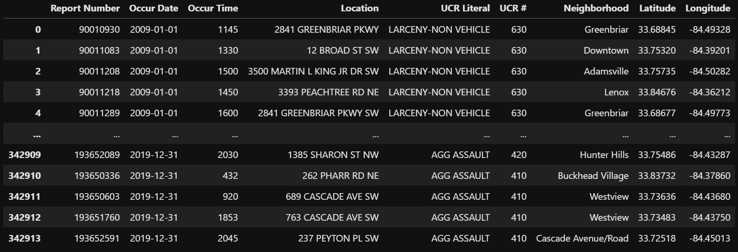
Data Analysis
Dataframe for Atlanta Crime Data

Slide 6
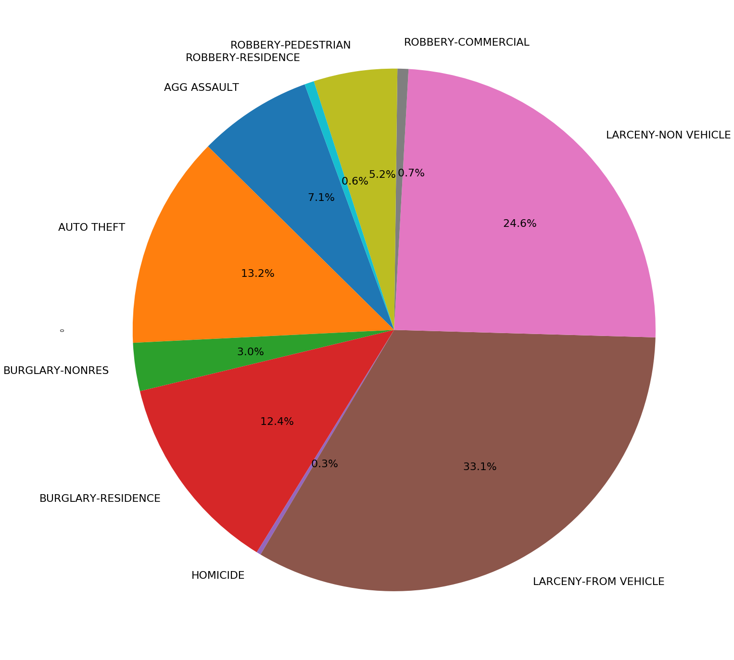
Pie Chart – Types of Crimes

Slide 7
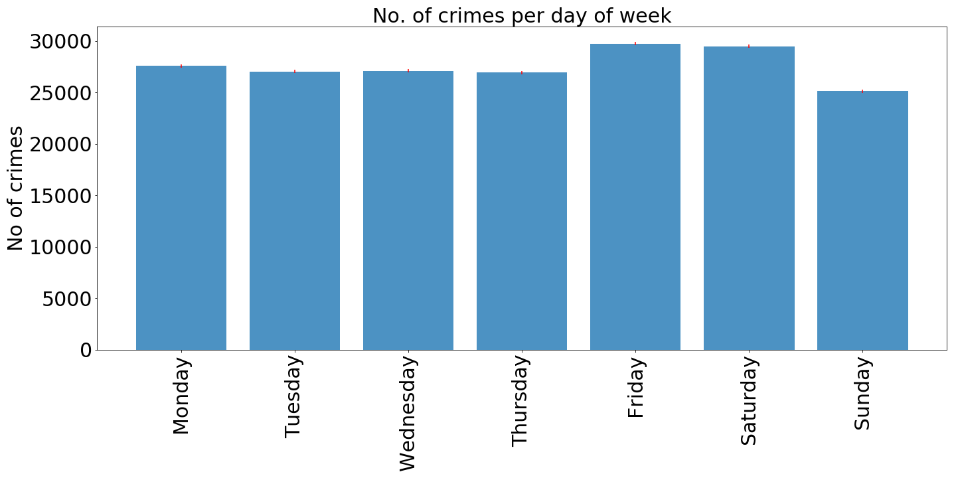
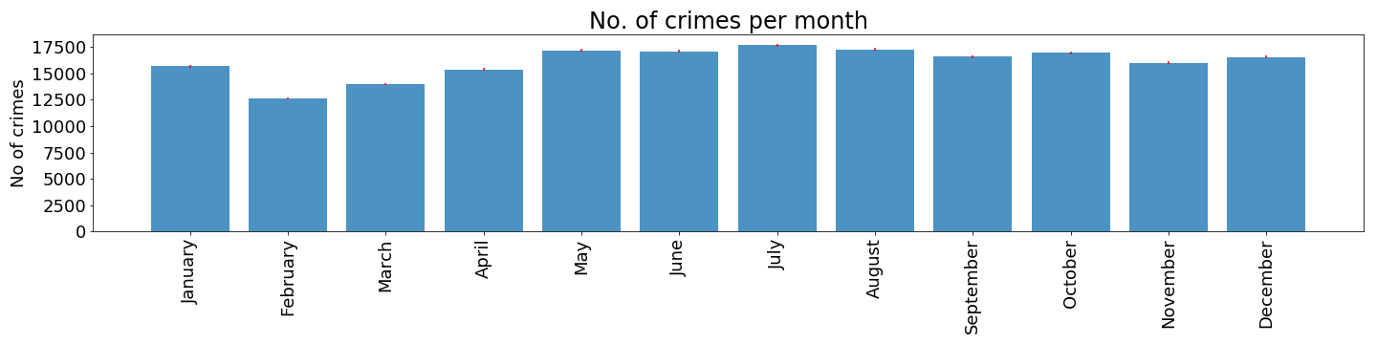
Crime by Day of the Week / Month

Slide 8
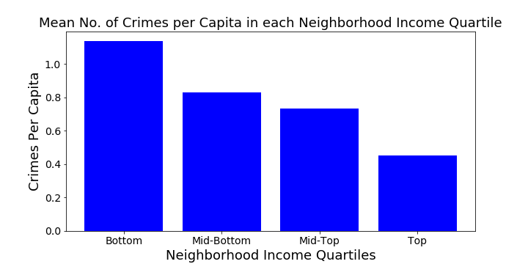

Slide 9
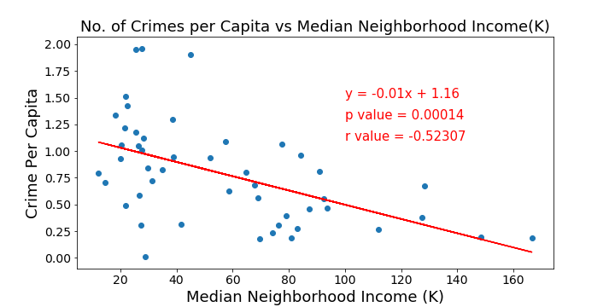

Slide 10
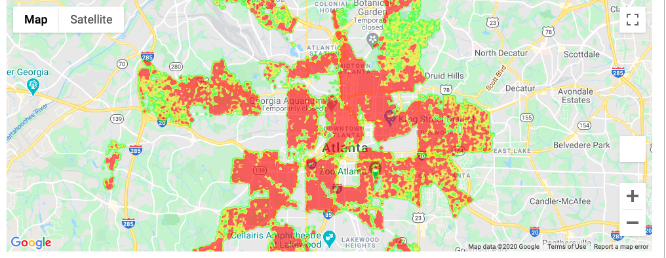
Heat Map – Crime Density

Slide 11
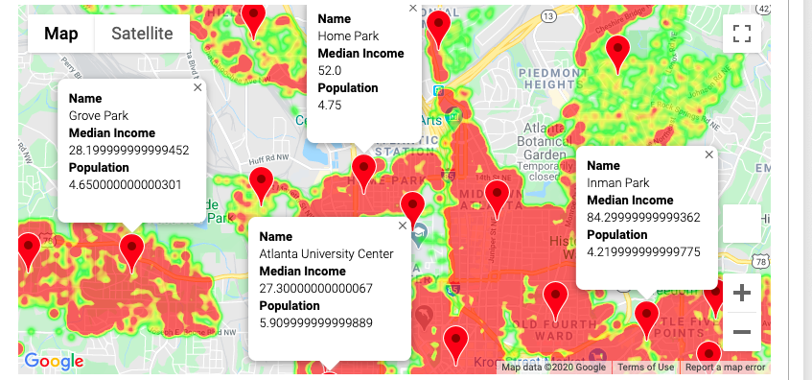
Heat Map – Neighborhood Labels

Slide 12
Discussion
We found that the most common type of crime is Larceny From Vehicle, the least common is Homicide
We found that the neighborhood with the highest median income was Paces (third lowest per-capita crime rate), the neighborhood with the highest crime per-capita was Westend
The lowest crime rate per-capita was Georgia Tech, the next lowest was Knight Park / Howel Station
We found that the most crimes happened in June followed by July, February was the least
We found that the most crimes occurred on Friday, the least on Sunday

Slide 13
Post-Mortem
One issue we came across is that it was difficult to find income data broken out by neighborhood
The crime data was limited, there were categories that were missing (such as drug crimes)
While the crime data set was a span of 10 years we were only able to get income data for a single year
We wanted to look at average home prices in addition to median income level, however we did not have time to explore this data set

Slide 14
Conclusion
Null Hypothesis: There is no relationship between income level and crimes per-capita in a given neighborhood
The following are the results from our linear regression
P value = 0.00014
R value = -0.52307
With a P value < 0.05, we show that an increase in median income is correlated with a decrease in crimes per-capita
Also, our R value shows that there is not a strong linear correlation between median income level and crimes per-capita

Slide 15
Questions?

